Slide 1
Brief Intro to
Geospatial Data
Modified from “Overview of Geospatial Data” by Patty Frontiera, Drew Hart, and Hikari Murayama of UC Berkeley’s D-Lab, used under CC BY-NC-SA 4.0.
Notes:
To get us started, and before we dive into any coding, let’s go over some core geospatial concepts.
Q: Raise your hand if you’ve worked with geospatial data before
More figures for later: https://www.geoawesomeness.com/top-7-maps-ultimately-explain-map-projections/

Slide 2
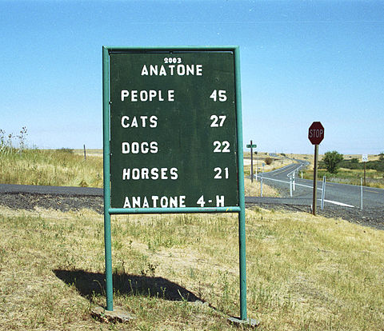
Geographic data
A single unit of geographic data includes:
Location (where): Anatone Attributes (what): data that describe the location
Also great to have metadata: When: 2003 Who: Anatone 4-H How: local census?
Notes:
Source: https://upload.wikimedia.org/wikipedia/commons/thumb/e/ee/Anatone_WA.jpg/640px-Anatone_WA.jpg
Geographic data, on the other hand, is data that could answer the questions “where” and “what”. In this example we have “Anatone, WA” as the where, and the what could be the data that describes the location (like this sign post).
Metadata in our context is specified as something that “[This standard] provides information about the identification, the extent, the quality, the spatial and temporal aspects, the content, the spatial reference, the portrayal, distribution, and other properties of digital geographic data and services.” (ISO 19115:2013 "Geographic Information – Metadata). In includes information about when the file was made, who made it, the geographic span, and more!

Slide 3
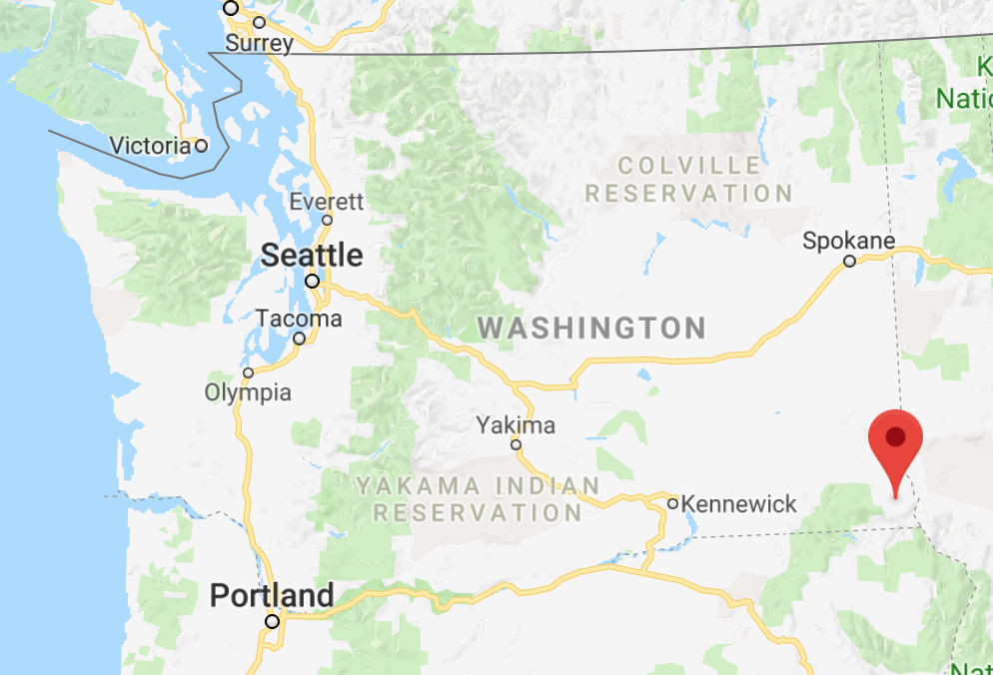
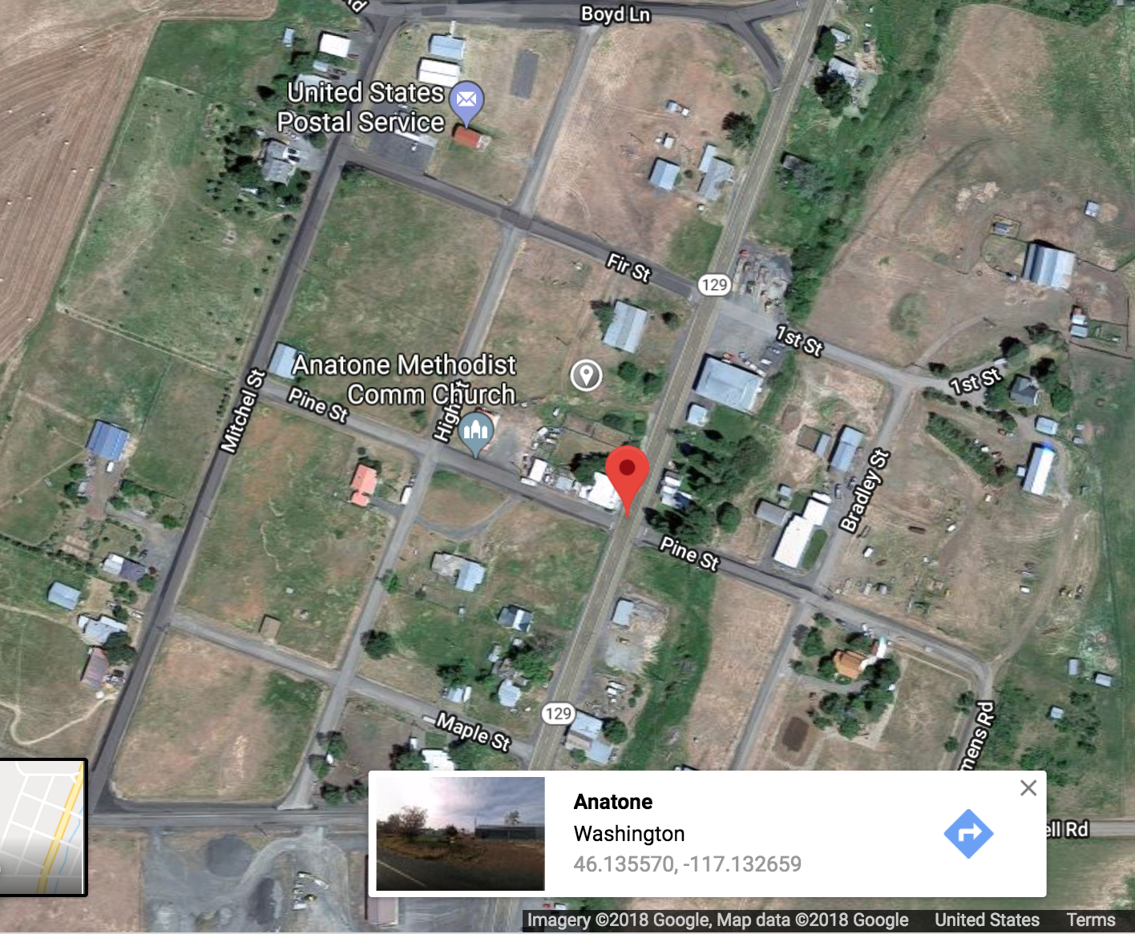
Geospatial data
Encodes location geometrically with coordinates: Anatone, WA: 46.130479, -117.134167
BUT, how do we know that those coordinates reference that specific location?
Notes:
So Geospatial Data is a location that is given by a set of coordinates. Anatone WA has specific coordinates associated with its location, a latitude and a longitude. The specific values we use to answer the question of “where” can differ by the coordinate reference system we use.

Slide 4
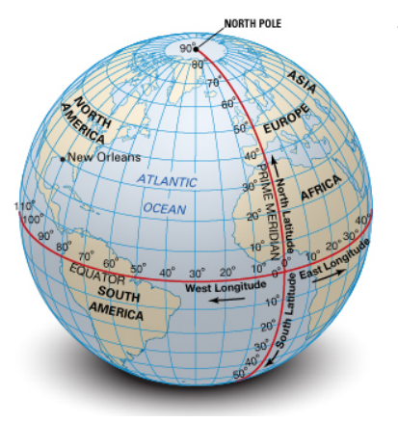
Coordinate Reference Systems (CRS)
A Coordinate Reference System, or CRS, is a system for associating coordinates with a specific, unambiguous location on the surface of the Earth.
New Orleans = 30N, 90W
Notes:
Coordinate References Systems, or CRS for short, is a way to give numerical coordinates for a position on earth. So for Anatone, WA we used a specific pair of latitude and longitude numbers to specify where it is on planet earth.

Slide 5
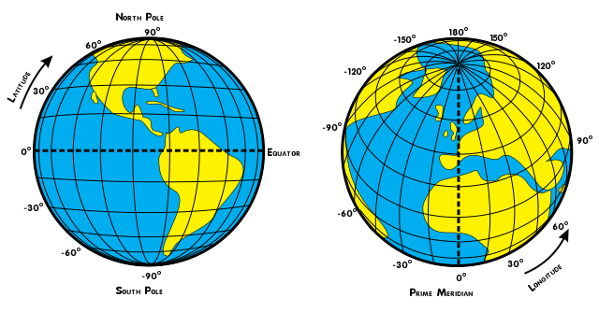
Coordinate Reference Systems (CRS)
Geographic Coordinates: Latitude and Longitude
http://latitude-longitude.net
Notes:
These latitude and longitude pairs are what make make geometries geographies! With this pair of numbers you can point to a specific point on the globe.

Slide 6
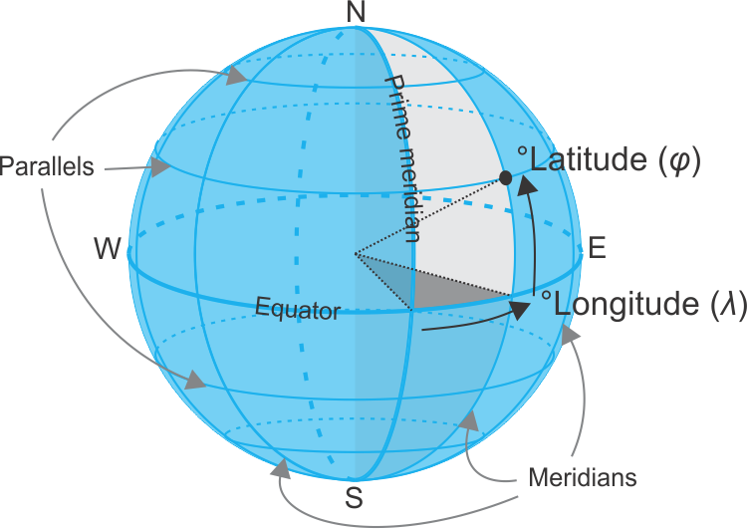
Coordinate Reference Systems (CRS)
There are many CRSs, not just one!
Why? Because our understanding of and ability to measure the shape of the earth has changed over time.
Notes:
Anatone, WA could actually have different pairs of values depending on the CRS we use. This is because there are different CRSs, with each one based on a different set of knowledge about the shape of our earth. Well what do I mean by that...

Slide 7
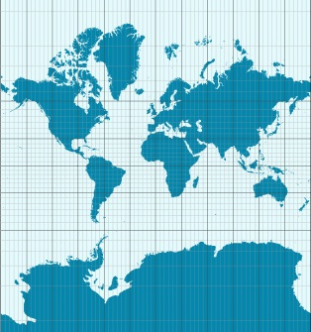
Two Types of Coordinate Reference Systems
Geographic CRS
Projected CRS
Angular Units = Degrees (DMS or DD)
Cartesian Units = Feet or Meters
Good for local & regional mapping & analysis
Notes:
So we have two types of CRS: Geographic and Projected
GCS is good for storing data and has units of degrees
PCS is good for analyzing data and has units of feet or meters
Let’s go through these two types in detail

Slide 8
Geographic Coordinate Systems (GCS)
Widely used! Expressed as latitude & longitude
WGS84 (EPSG: 4326)
Based on satellites, used by cell phones, GPS
Best overall fit for most places on earth
NAD83 (EPSG: 4269)
Based on satellites and survey data
Best fit for USA
Used by many federal data products, like Census data
CRSs are referenced in software by numeric codes, often called EPSG codes
Notes:
GCS are actually quite popular and as you become more familiar with geospatial data and work with different datasets, two CRS you will probably run into are WGS84 and NAD83.
Why do you think people will use different CRS for different places or reasons? Sometimes different CRS work better in one location rather than another. NAD83 is actually great to use if you’re looking at the US. Those 4 digit numbers you see next to NAD83 is the EPSG code. These codes are what you’ll be using in Python and R to designate a specific CRS.

Slide 9

Earth is not flat!
But computer screens, paper maps and most of the math underlying spatial analysis methods assume it is!
We use map projections to transform geospatial data from a 3D model of the earth to a 2D plane.
This causes distortion :(
You need to understand how this might impact your maps and spatial analysis!

Slide 10

Notes:
Image source: https://www.esri.com/arcgis-blog/products/arcgis-pro/education/earth-peel/
Here is our orange… let’s pretend now that it is perfectly spherical

Slide 11
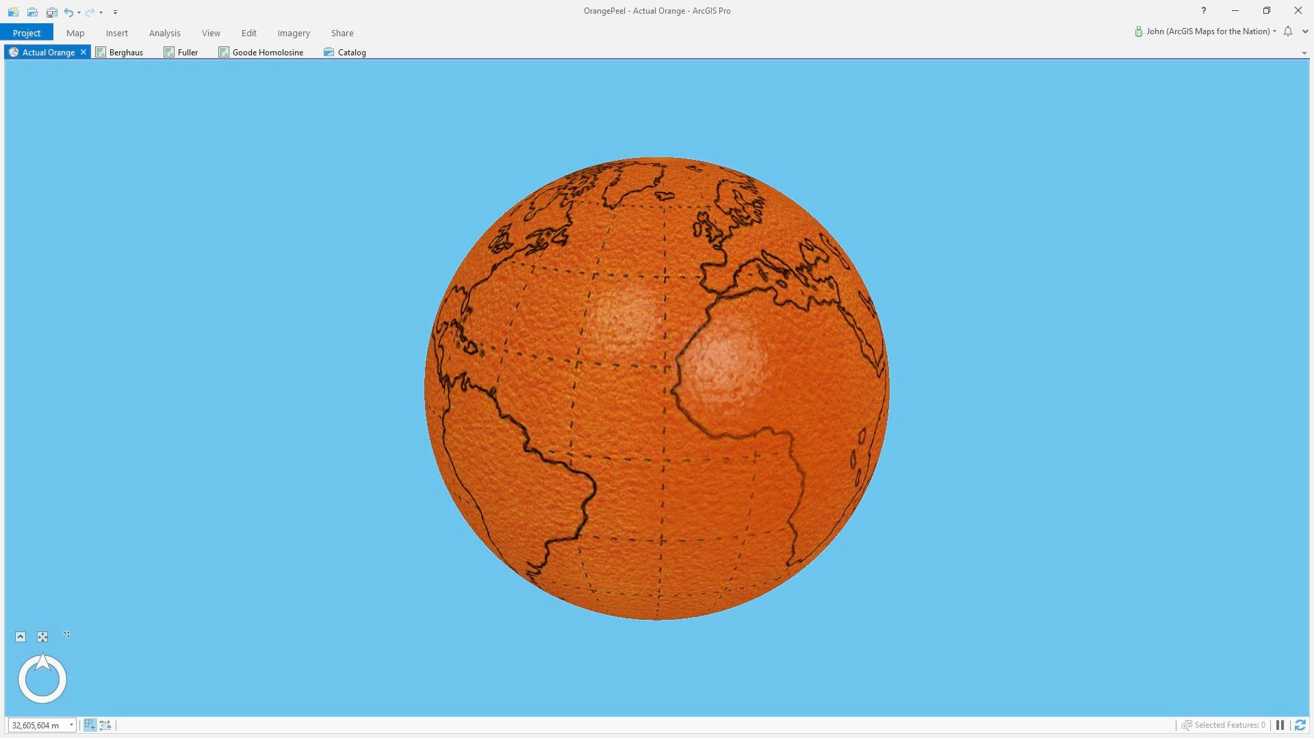
Notes:
Image source: https://www.esri.com/arcgis-blog/products/arcgis-pro/education/earth-peel/
Ta-da! And we’ll go ahead and draw all of our continents on here. Now that we have this lovely rendition of earth, we’ll go ahead and peel it.

Slide 12
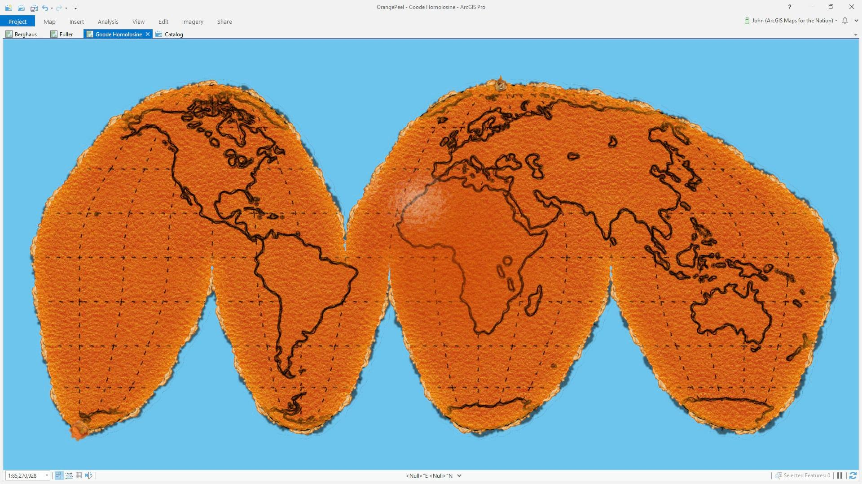
Notes:
Image source: https://www.esri.com/arcgis-blog/products/arcgis-pro/education/earth-peel/
And here’s one way to peel it,. This looks pretty similar to the maps you see when you google “world map” or the ones that were hung up in your elementary school classroom. But then thing is you can peel an orange multiple other ways

Slide 13
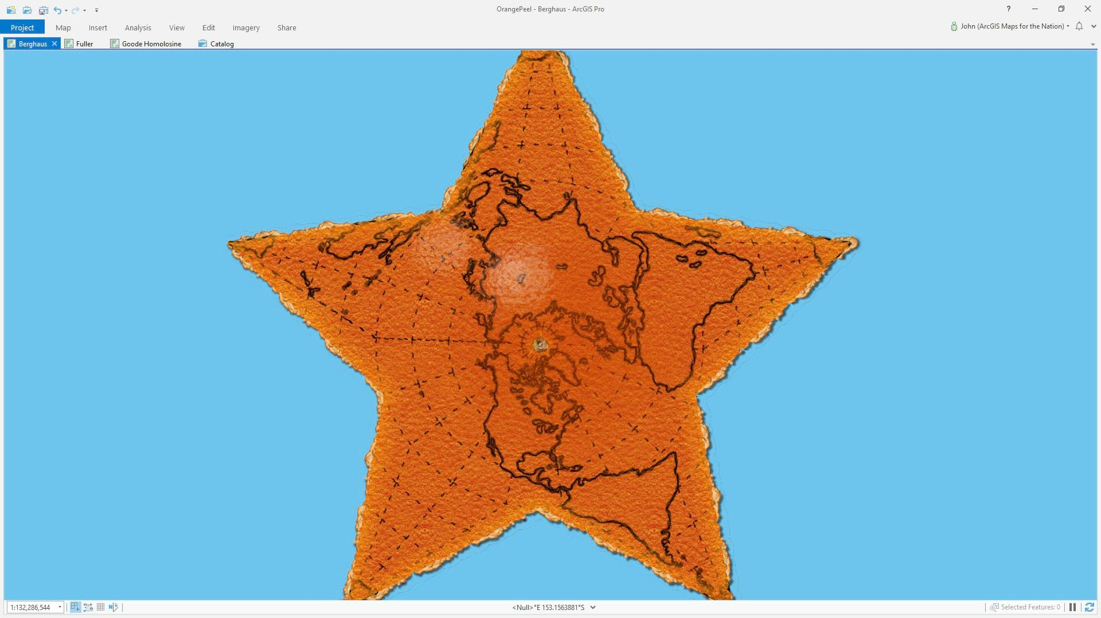
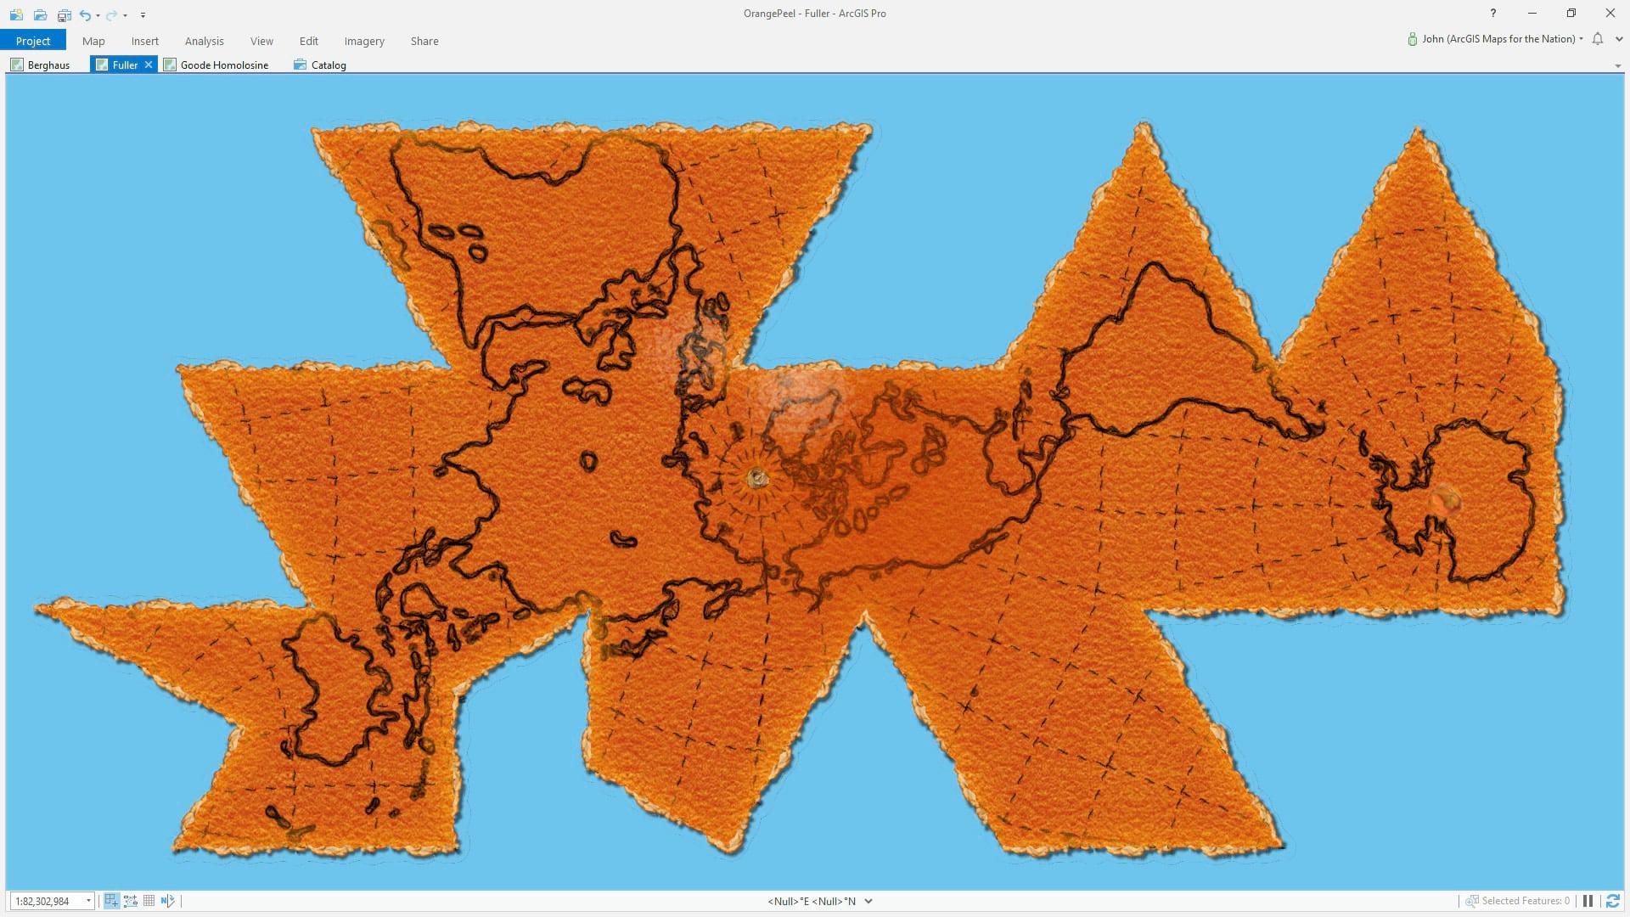
Here’s a fun video about funny fruit maps: Link

Slide 14
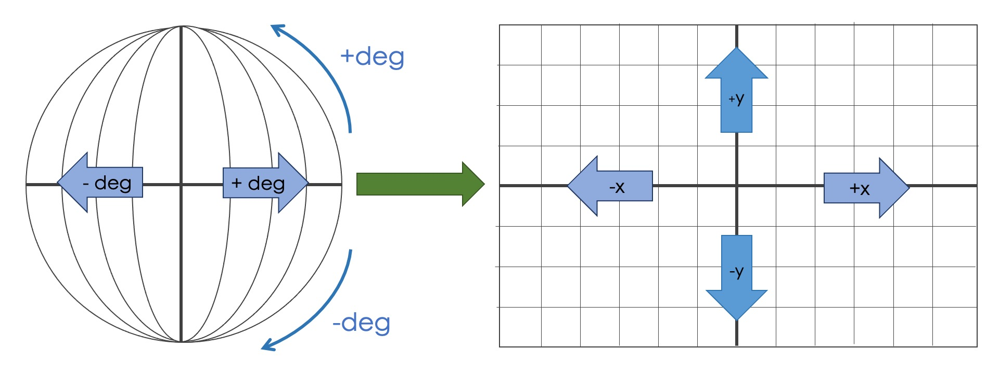
Projected Coordinate Systems (PCS)
Map Projections transform geographic coordinates (lat/lon) to 2D coordinates (X/Y)
All map projections introduce distortion in area, shape, distance or direction.
Specific map projections minimize distortion in one or more properties
You need to know the coordinate reference system of your input data
You need to select the CRS that is most suitable for your data and application.
Notes:
PCS on the other hand introduce distortion since we’re looking at our locations on a flat plane. But this makes them great for area, shape.. And general measurements of distance. As with GCS, PCS also have some systems that are better for some locations other than others.

Slide 15
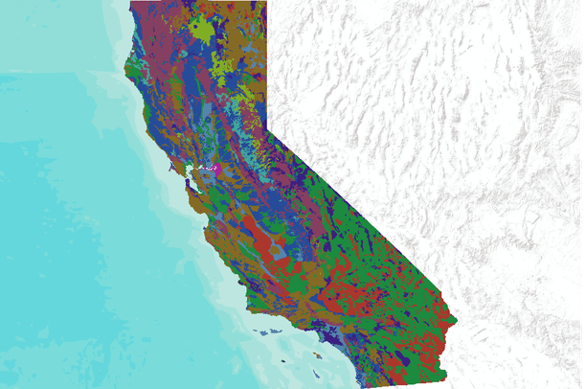
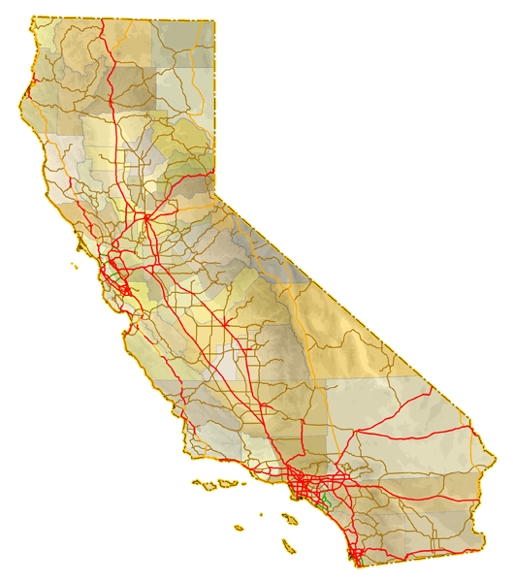
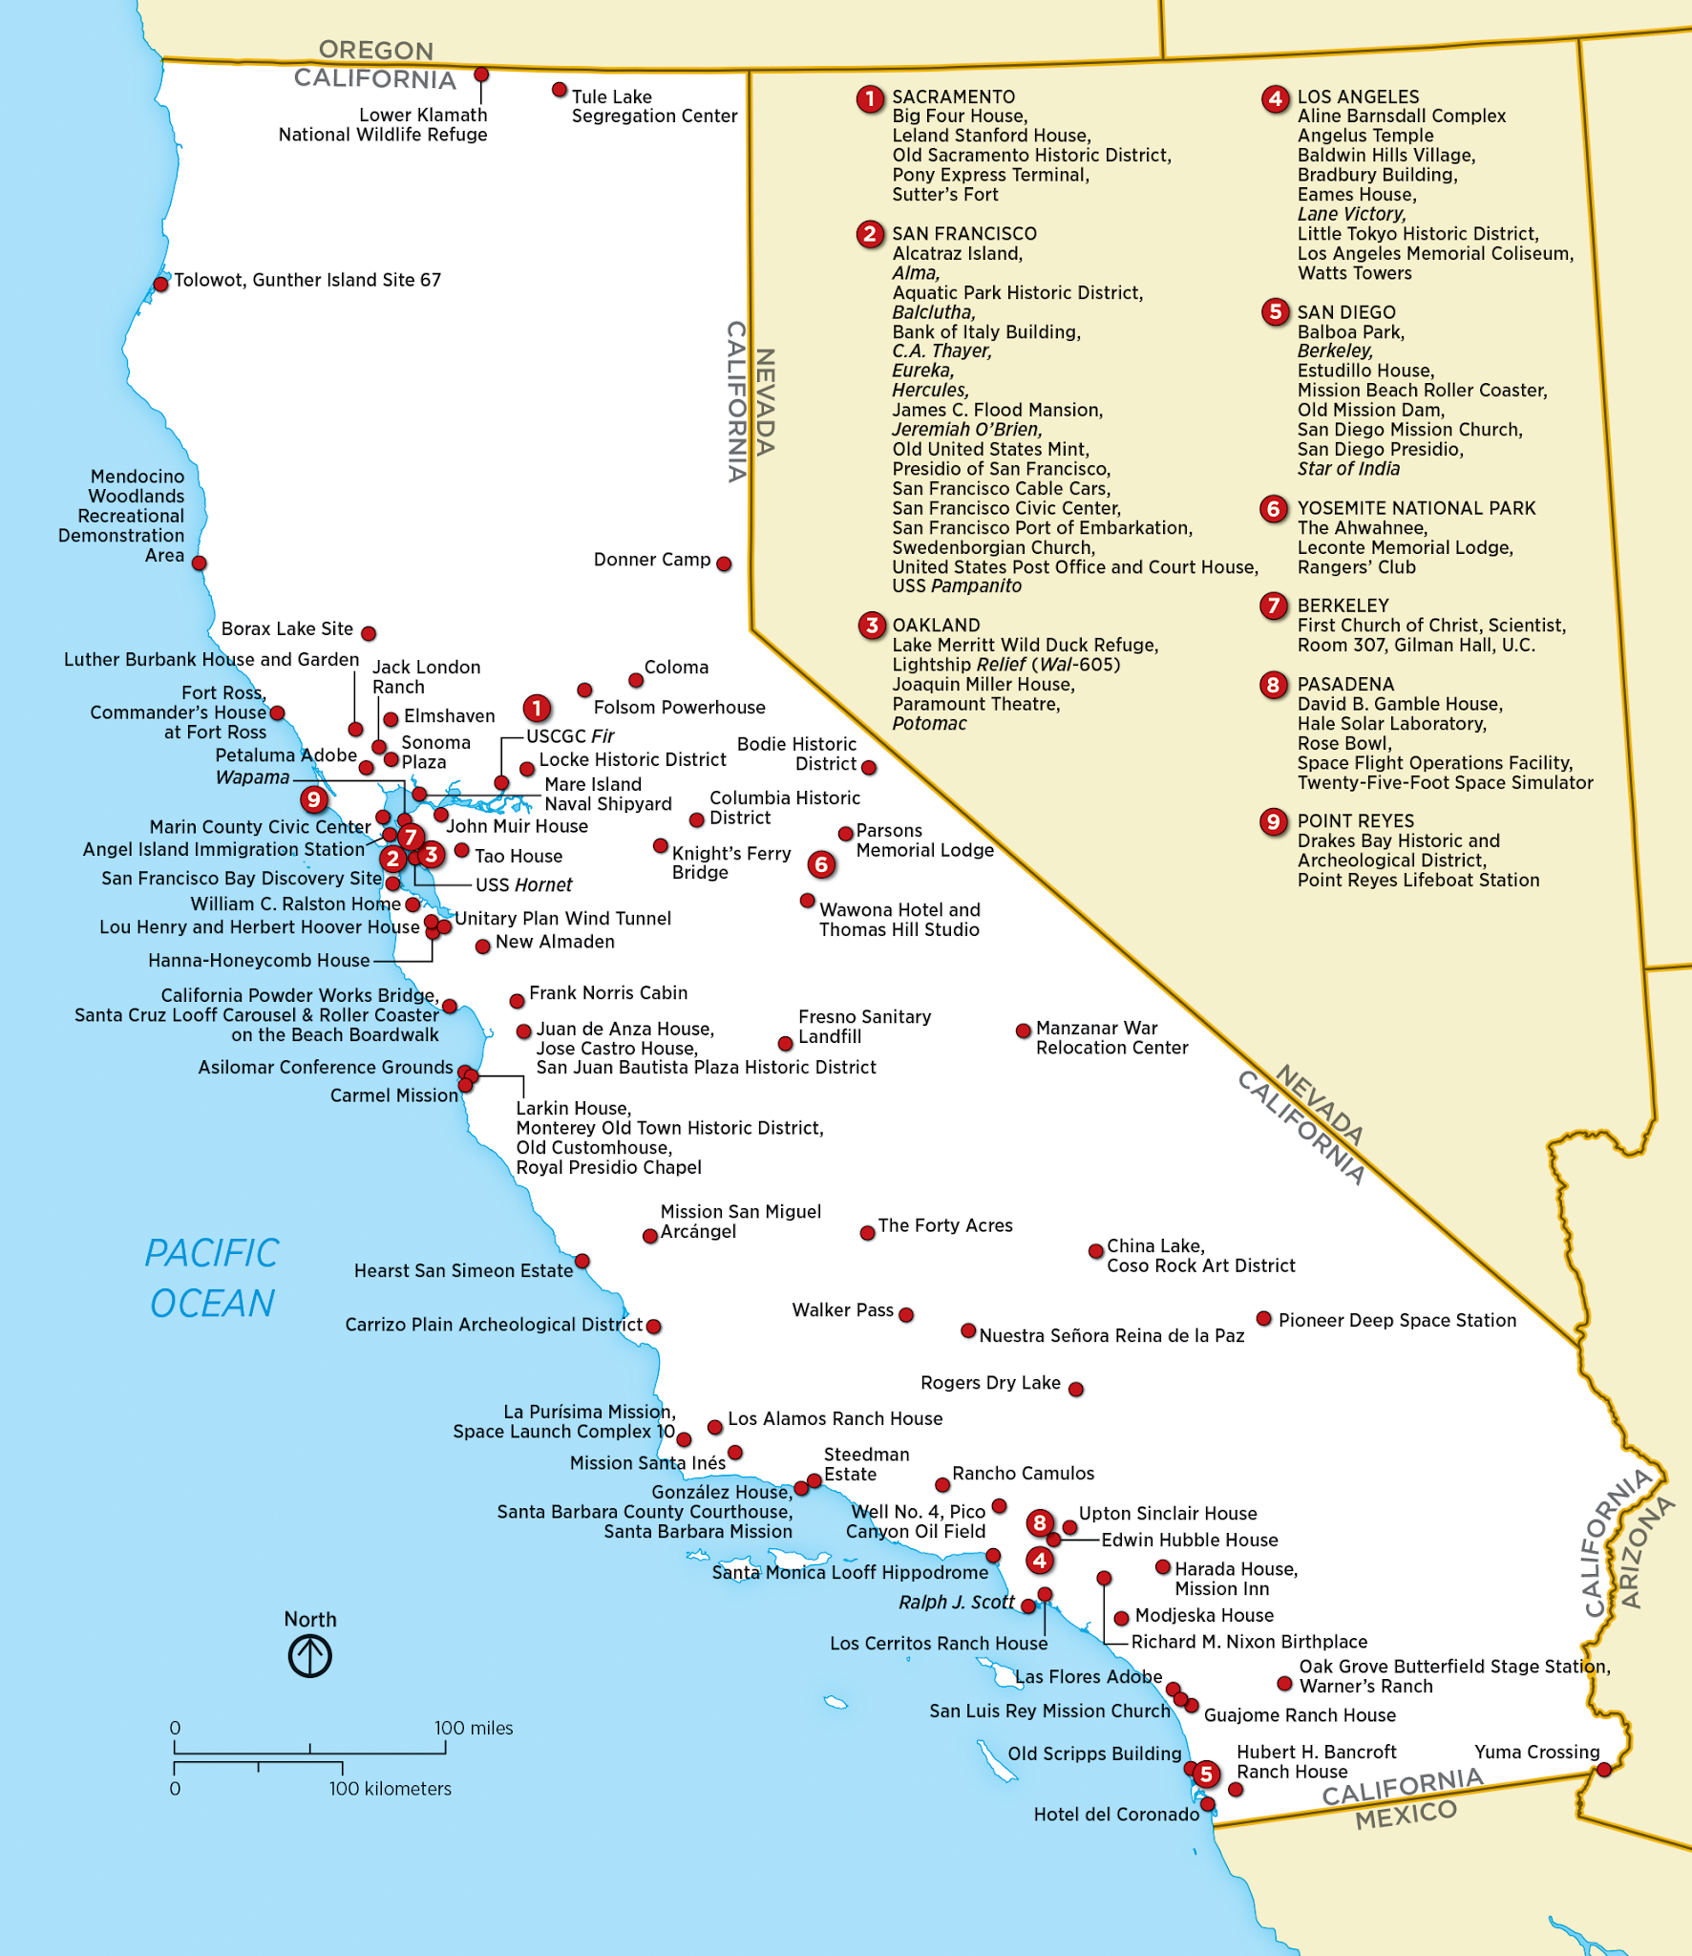
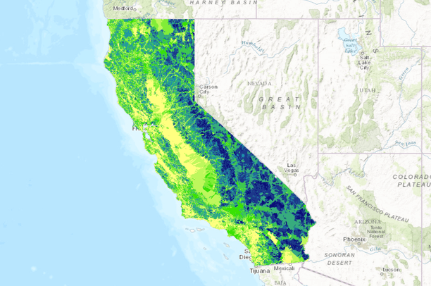
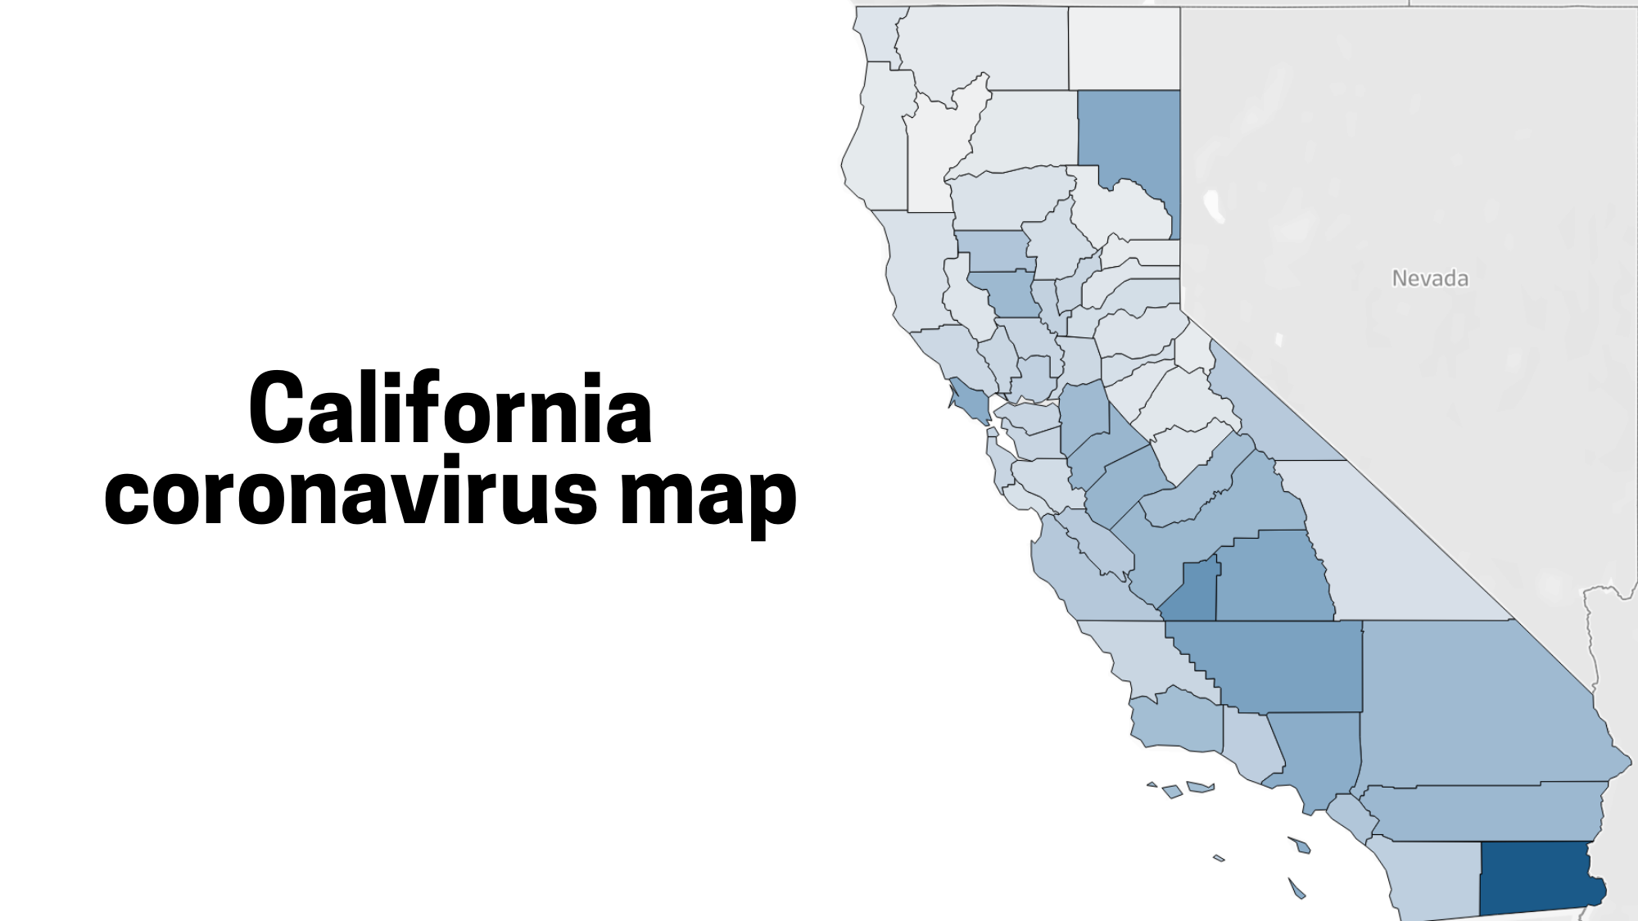
Types of Spatial Data
Notes:
So now that you all have a firm footing in a core concept behind geospatial data, coordinate reference systems, we’ll jump into the different types of spatial data you will encounter.
Img credit: state soil demographic https://databasin.org/datasets/1ff4328039f948529c33e7e71bb9b5fc
Img credit: watershed health https://databasin.org/maps/d20b406693764ce7bcce339539089448
Coronavirus: https://www.mercurynews.com/2020/03/20/map-coronavirus-cases-in-california-by-county/
Roadway: https://www.aaroads.com/california-highways/
Landmark: https://en.wikipedia.org/wiki/List_of_National_Historic_Landmarks_in_California

Slide 16
Types of Spatial Data
There are two fundamental spatial data models:
Vector
Raster
Notes:
Geospatial data can be divided into two categories--- vector and raster.

Slide 17
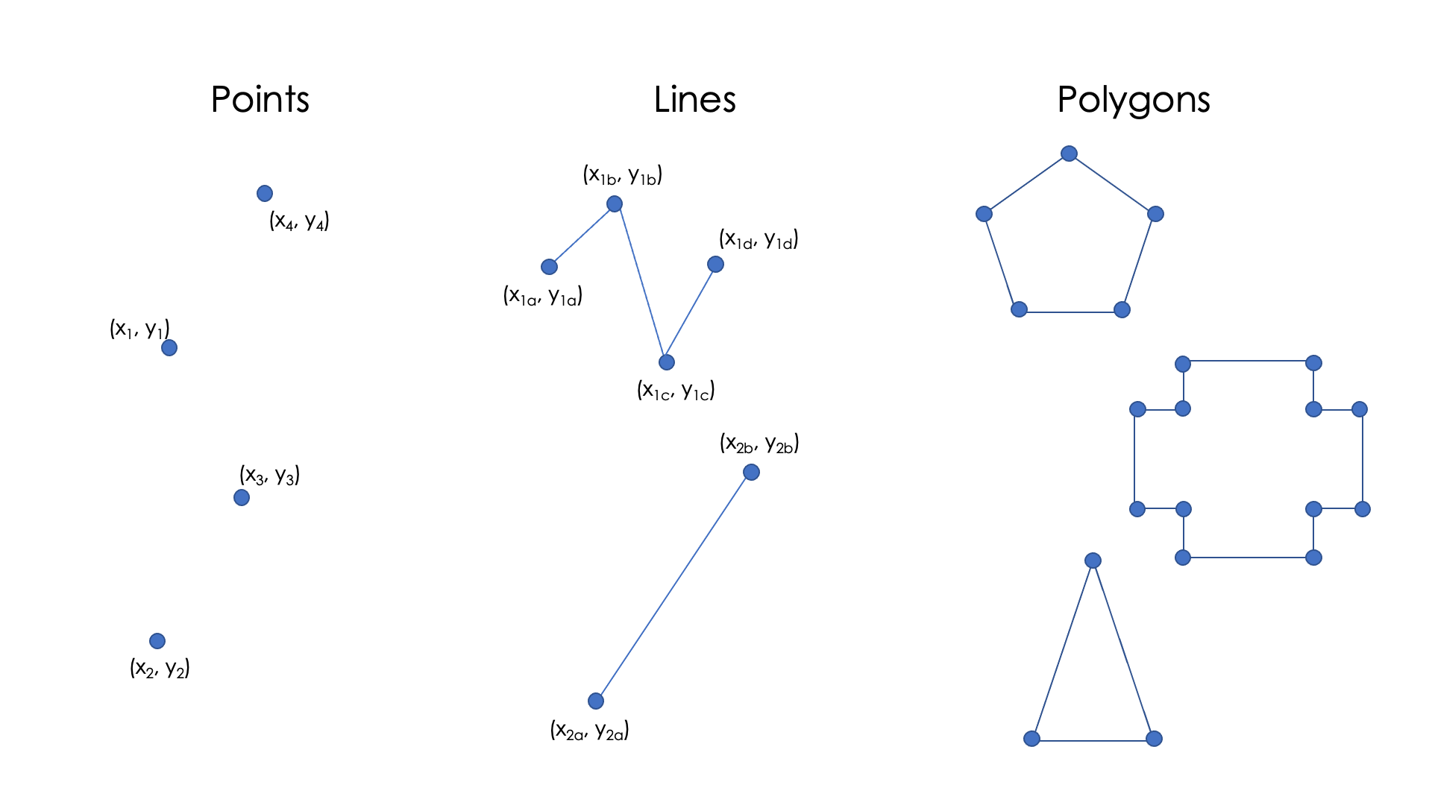
Vector Data
“Connect the dots”
Notes:
Vector data can be thought of data that you can connect the dots with. This type of data can include points, lines, and polygons.

Slide 18
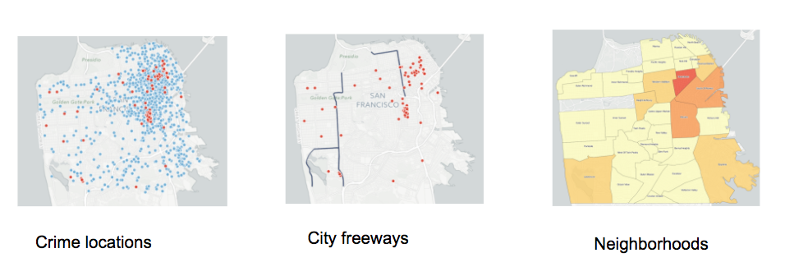
Points, Lines, Polygons
Notes:
Each of these geometry types can be for a different type of information. Points could be great for showing us where crimes have occurred historically. Lines could show us the location and length about where freeways are in the city. Polygons could help us show different information about different neighborhoods.

Slide 19
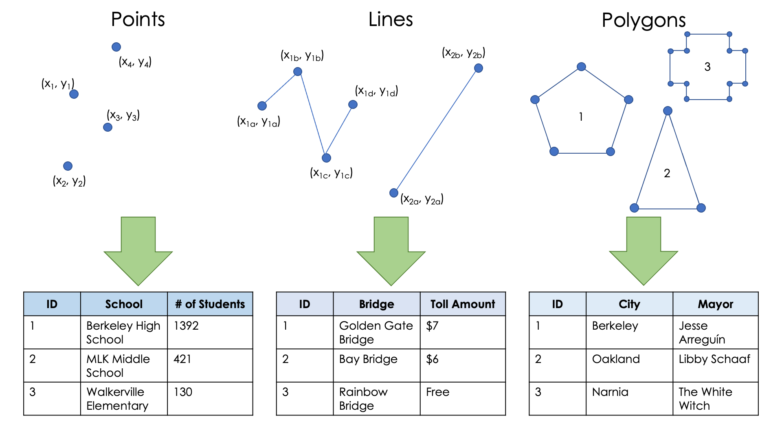
Vector Data with Attributes
Each row represents one geospatial feature
Attributes describe the features (fields or columns)
Each feature has an associated geometry or geometry collection
A group of features is called a layer
Notes:
We’ll now briefly talk about what this vector data looks like when you open it up.
You might get something like the table you see on the right side of the screen. Each row represents one geospatial feature. So for our second attribute we have the ID number 2, the plot size 20, vegetation type, and a vegetation class of deciduous. Those additional information I just rattled off to you like the plot size, are attributes. These help describe our features.
Furthermore, each of these features have an associated geometry or geometry collection. So in our first table our geometry is a point,
One last thing about vector data-- each group of features is called a layer. So you could have all three of these data, and each dataset would be its own layer.
I’ll pause for a moment for any questions. Feel free to drop them in the chat or unmute to ask your question.

Slide 20
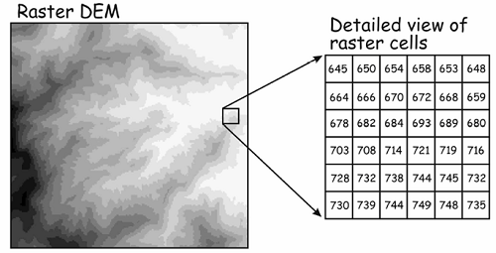
Raster Data - regular grids
A location is represented by a grid cell
Cells have regular size, eg 30x30m
Grid has dimension - fixed number of rows and columns
Each cell has a value that represents the attribute of interest, e.g. elevation
(Digital Elevation Model)
Notes:
Now let’s go to Raster data! Do you notice anything about this image that seems different from what we had looked at for vector data?
RIght, so raster data looks more continuous. Our dataren’t defined by geometries--- rather, it’s like this quilt of little squares, each square holding a value. These squares could be something like 30 by 30meters, and each one could hold information such as elevation.

Slide 21
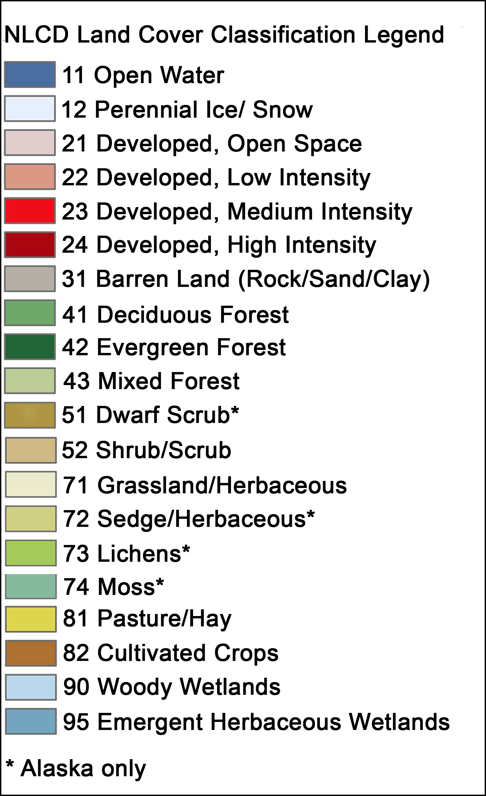
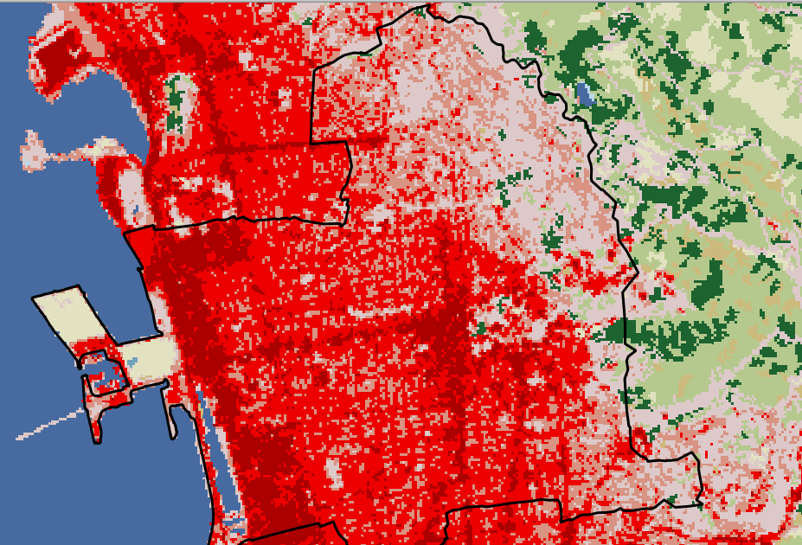

Categorical Raster Data
30m pixels

Slide 22
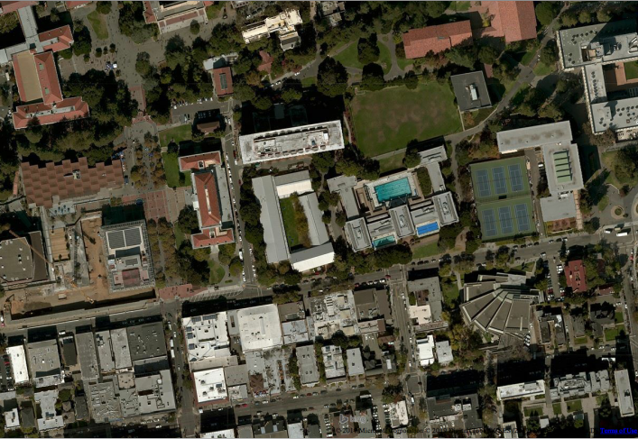
Imagery Data are Raster Data
Note:
Aerial imagery, satellite data and other remotely sensed geographic data are commonly used as sources of vector data
In other words, the building footprints or streets can be digitized off of the imagery and saved as vector data.
Source: BING Aerial imagery
Notes:
One common raster data type is images! If you zoom way way in into this something like this picture, you’d see squares of different colors.

Slide 23
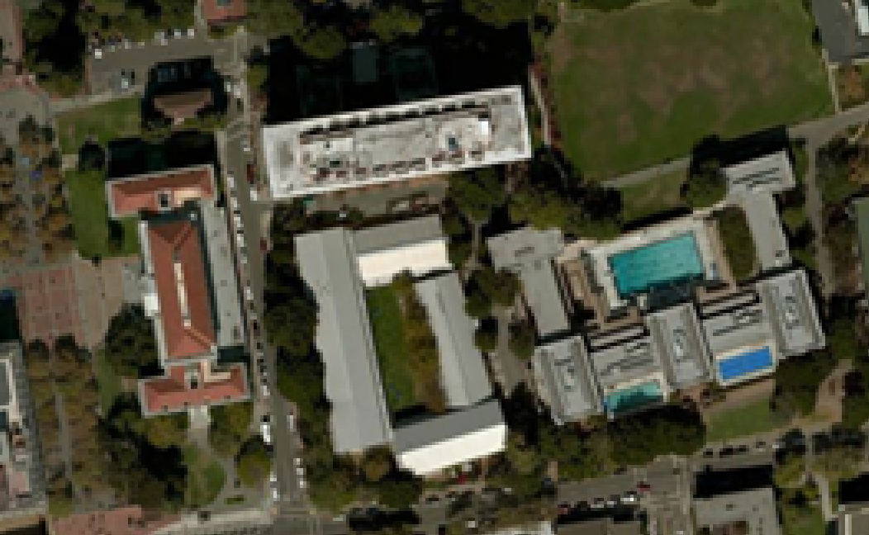
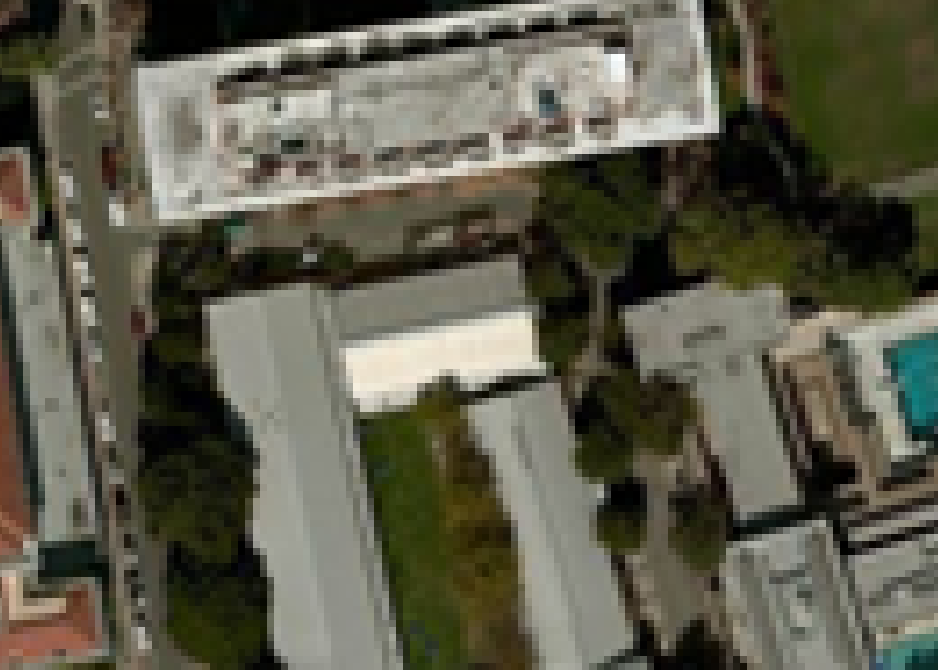
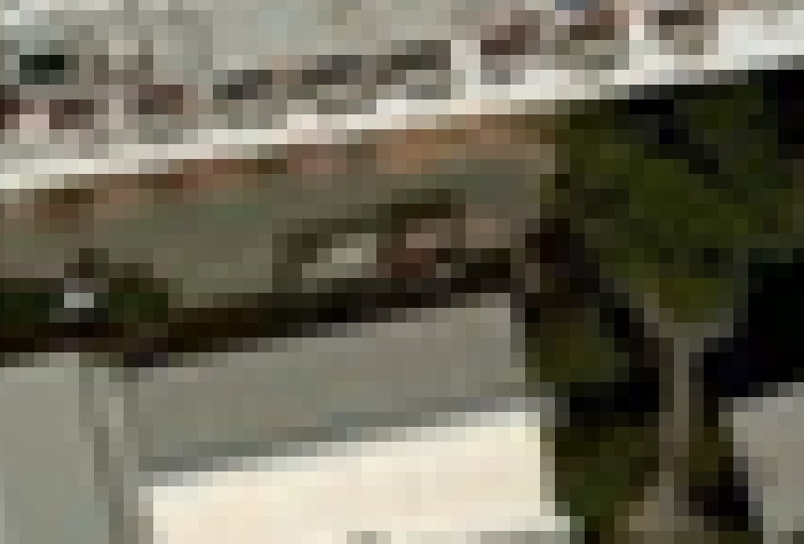

Slide 24
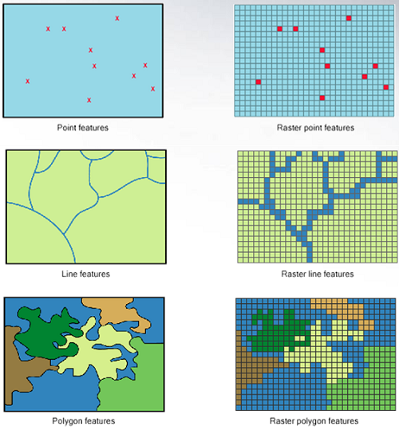
Vector vs Raster
Vector data are better for
discretely bounded data
e.g. political boundaries, fire hydrants, rivers, roads, etc.
Raster data are better for
continuous data
e.g. temperature, elevation, rainfall, etc.
Image: http://gsp.humboldt.edu/
Notes:
Now that we know we have these two types of datasets, we can talk about when to use each. Vector data are better for when you have discreetly bounded data. This could be for counties, rivers, etc. On the other hand, raster data is better for continuous data (like the image we just looked at), or maybe something like temperature, elevation or rainfall.

Slide 25
Some Common File Formats
Vector Data
Shapefile (.shp…)
GeoJSON, JSON
KML
GeoPackage
Raster Data
GeoTIFF
netCDF
DEM
Notes:
Now these two datasets come in different file formats, so you’ll know what it is before you pull it in for whatever GIS software you’re using. Some common ones I use are shapefile and geojsons for vector data, and geotiffs for raster data.

Slide 26
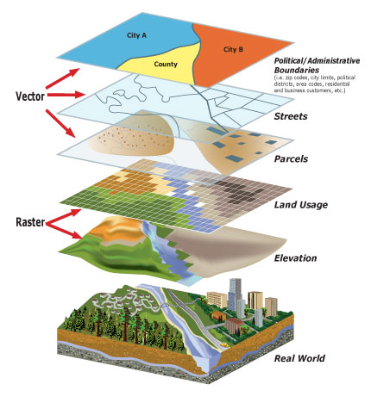
Georeferencing
Data layers in the same coordinate reference system can be linked dynamically to explore associations and build complex models of the real world
Notes:
Although these two types of data look different, and come in different formats, you can still use a combination of raster and vector data to answers questions that you’re probably aiming to answer through your own work.
I’m going to take a second breather here before we move on. What kind of questions do you all have?

